Slide 1
Self Service Console
Ad Hoc AM Gap Analysis: AM- onPrem product
Rough Workflows for NGA: Cloud product

Slide 2
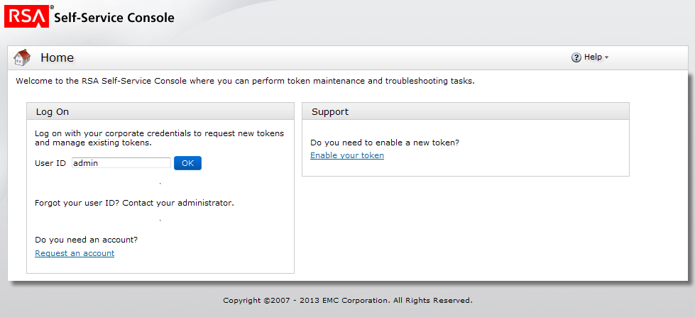
AM Log in Screen for End User

Slide 3
NGA Log In
Log in with your corporate credentials to request system access.
User Name
Password
Not sure we need these for NGA.
Think all we need is a simple log in screen
Need Help?

Slide 4
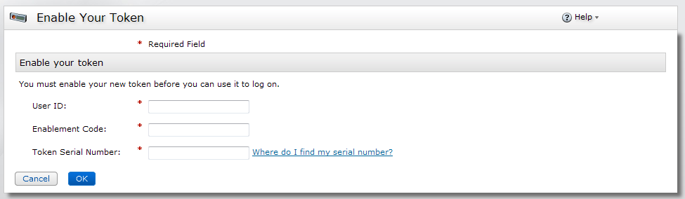
End User Enabling a token screen
We have this in NGA, but I think it should be a part of a wizard..see next slides

Slide 5
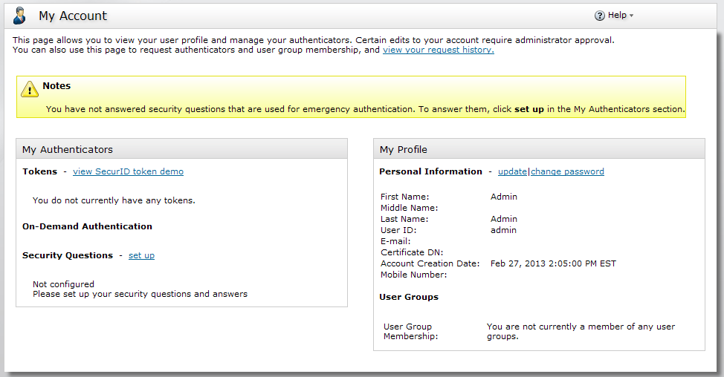
First Time User is prompted to set up security questions
Gap: not being able to set up other credentials to authenticate against, for example “take a picture for facial recognition”
The process seems fragmented and not a part of a cohesive enrollment process.

Slide 6
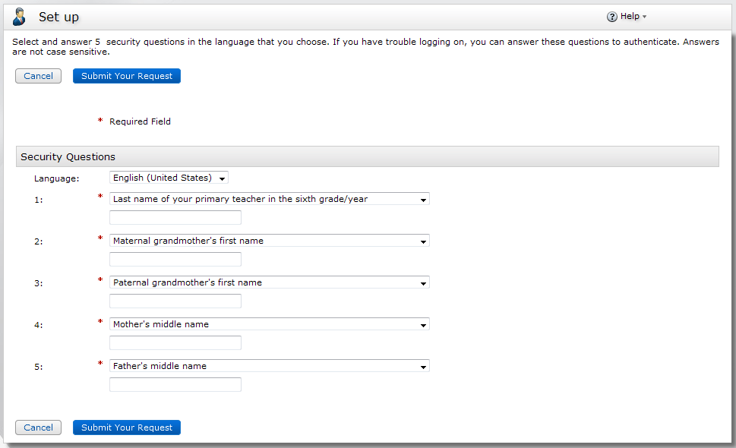
Step Up Questions
Does not allow for user to make up their own question or to configure a reminder or hint which is a best practice
Configure a Hint
Configure a Hint
Configure a Hint
Configure a Hint
Configure a Hint
Add Configure your own question.

Slide 7
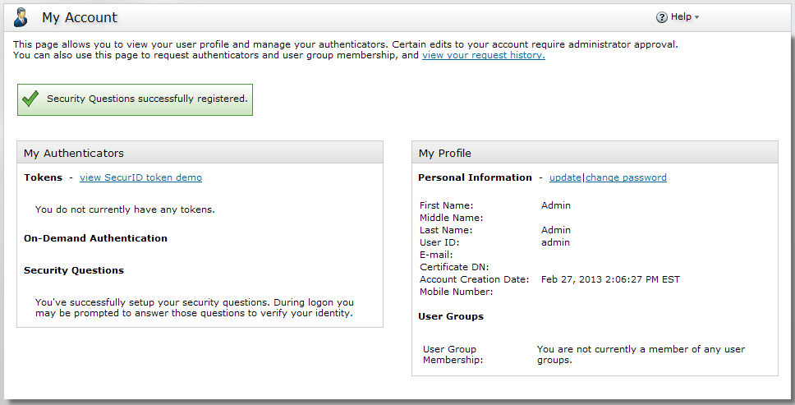
Confirmation:
There is are no “next steps” what if the user does not know they could set up an OOB SMS?
A wizard and one-stop enrollment area would be an improvement.

Slide 8
Proposed Workflow for NGA
Self Service Console

Slide 9
NGA Self Service End User Enrollment Screen
User logs into enroll in NGA…
RSA Self Service Console Configuration
Log in with your corporate credentials to request system access.
User Name
Password
Need Help?
End user sees this screen. It will be able to be customized by the Tenant or Subtenant.
Refer to Self Service Tenant/Subtenant Screen

Slide 10
Enrollment Wizard
RSA Self Service Console Configuration
Set Up or Edit your Enrollment Credentials
Security Questions
Mobile Enrollment
Biometric
Token Enrollment
Review and Submit
Instructional Text:
Default Security Questions 1-5
Make your Security Questions?
Provide areas for users to send hints to themselves.
Wizard steps
Editable by tenant/subtenant.
May configure the types of
Authentications they wish to require of their users.
Maybe there are more authentications required of users with higher levels of access?
Cancel
Next

Slide 11
More wizard screens to come for End User

Slide 12
Tenant or Subtenant Configuring SSC for their end users

Slide 13
Self Service Tenant/Subtenant
Logs in for the first time to customize and set up the self service requirements and portal for their end users.
RSA Self Service Console Configuration
Log in with your corporate credentials to request system access.
User Name
Password
Need Help?

Slide 14
Enrollment Wizard
RSA Self Service Console Configuration
?
Customize, Edit or Configure Enrollment for your employees
Save or Submit
Log In Page
Certificates
Enrollment Wizard
Instructions: Lorum Epsom…
Upload your Company Logo here Create an H1
Log in with your corporate credentials to request system access.
User Name
Password
Create Help Link
Preview
Cancel
Next

Slide 15
More wizard screens to come for Tenant/SubTenant

