Slide 1

RSA SID SW Token for iOS
UXD Team Design Review
6/18/2013

Slide 2
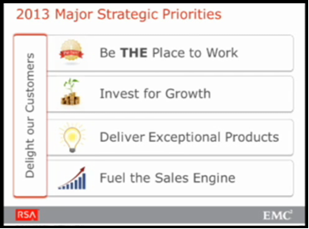
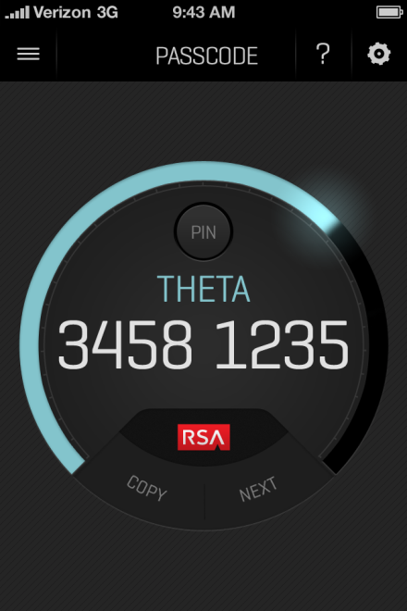
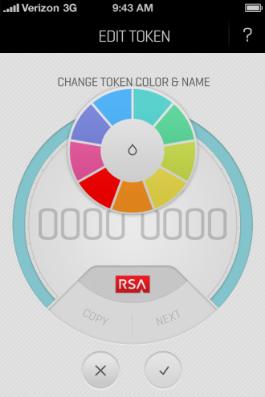
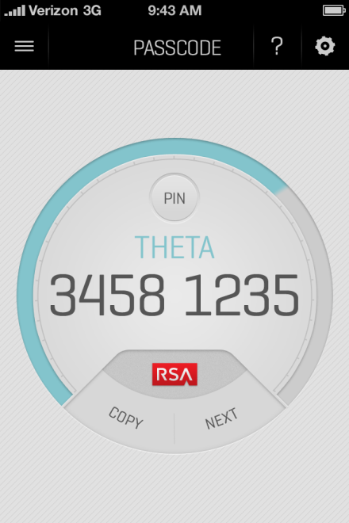
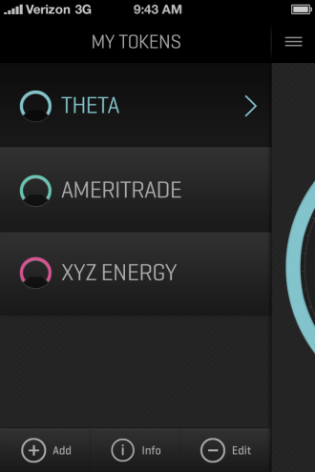
SOFTWARE TOKEN REDESIGN (iOS)
Background Context
External design consultant and Software Token UXD and PM members
Initial evaluation and design phases (late 2012)
Goals Related to UX
Delight our customer (wow & ease-of-use)
Differentiate us from our competitors (modern look-n-feel, ease-of-use)
Show brand standard consistency to the marketplace
Highlights: the new iOS Design
Modern visual design with a clean and simple interaction model
Associates innovation with our brand – graphical circular timer (i.e. RSA is trying new things and producing better designs with each major release)
Usability tested with external hardware and software users
Is fun, because you can personalize your token. (We have usability test quotes of people saying the color picker and name customization is fun.)

Slide 3

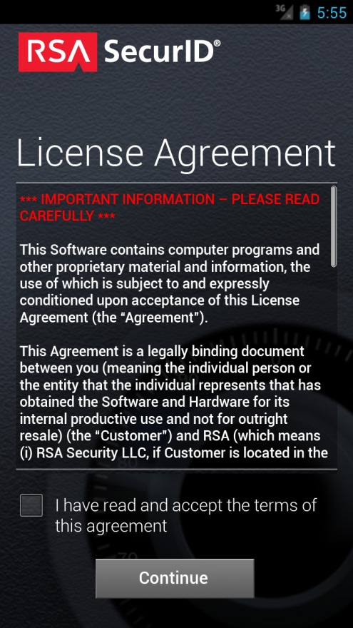
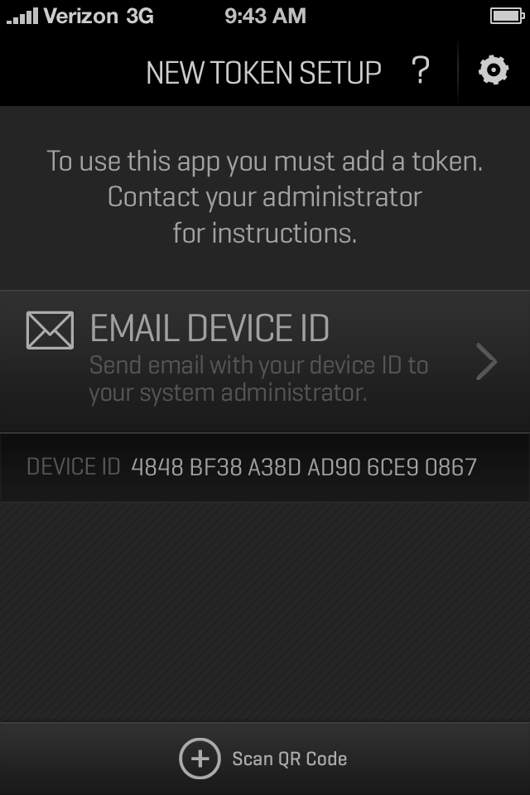
First Experience: Email Device ID
Font: Design uses (non native) Geogrotesque – PM may reject
RSA Logo: The RSA logo has a modern look to match app – Marketing may reject

Slide 4
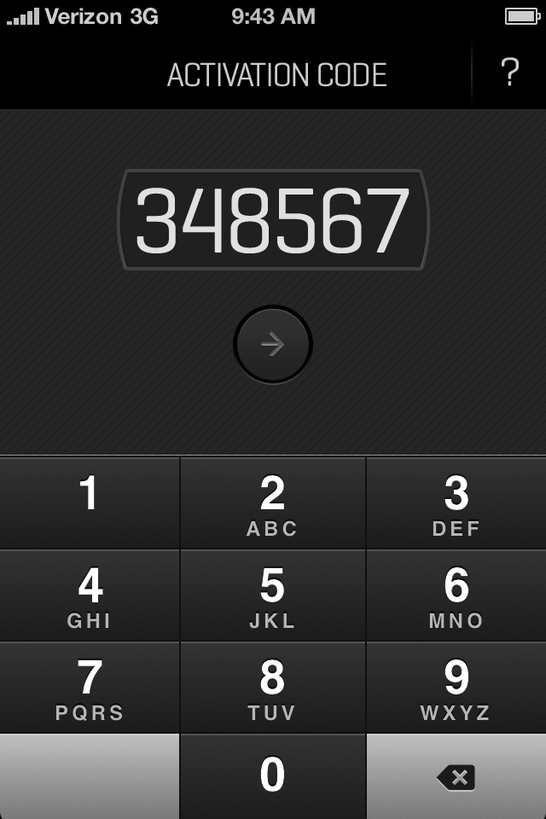
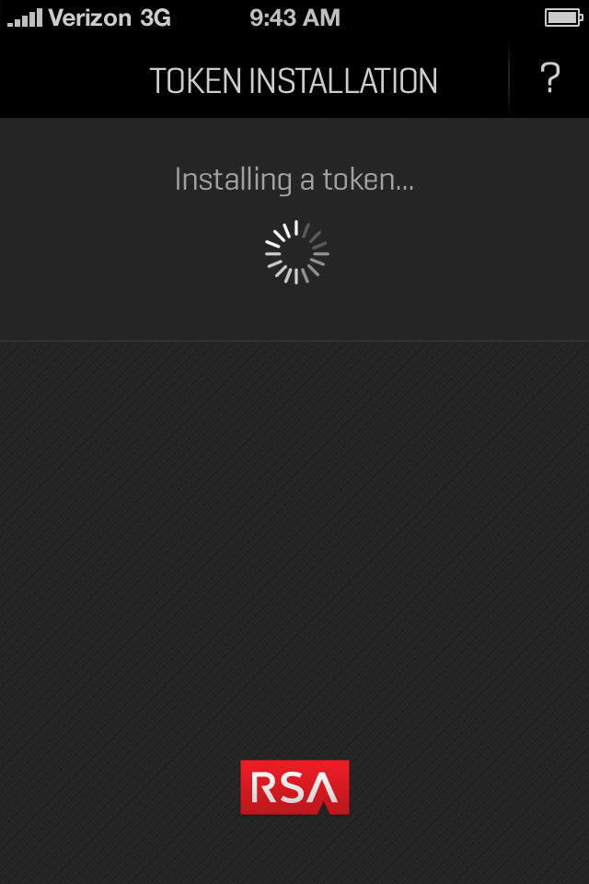
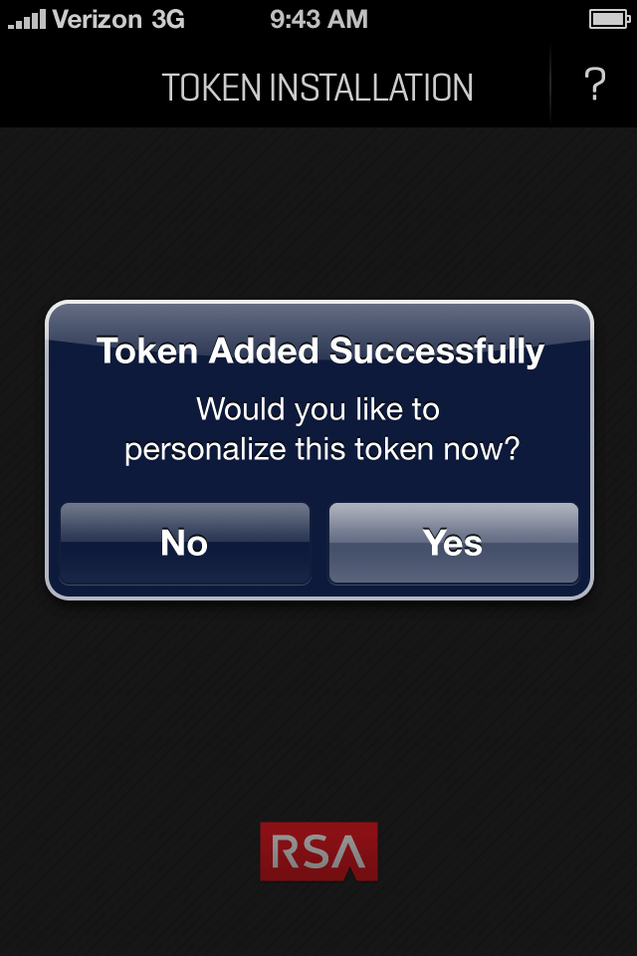
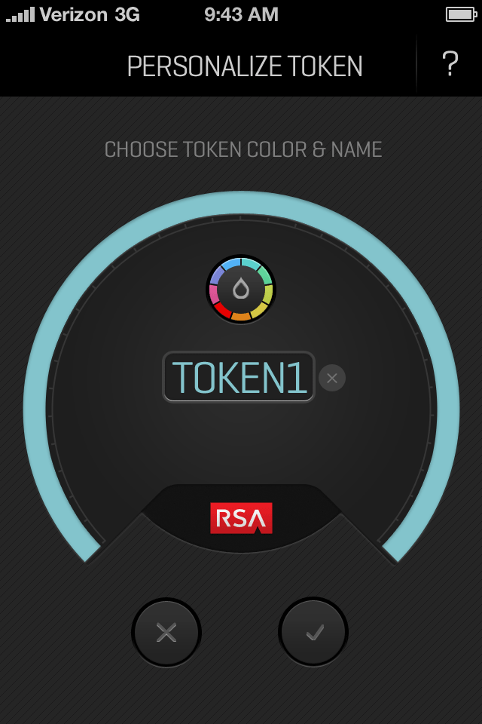
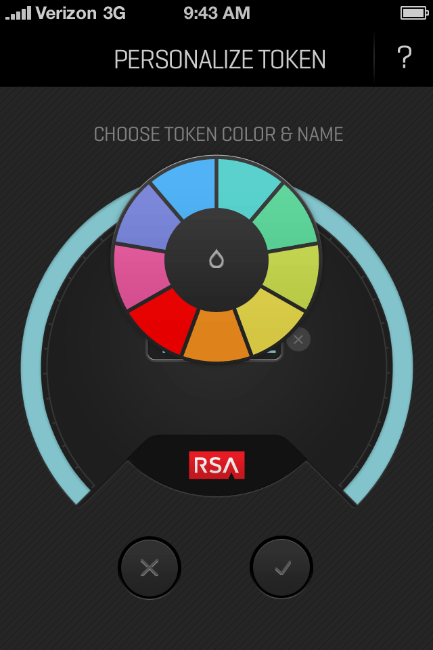
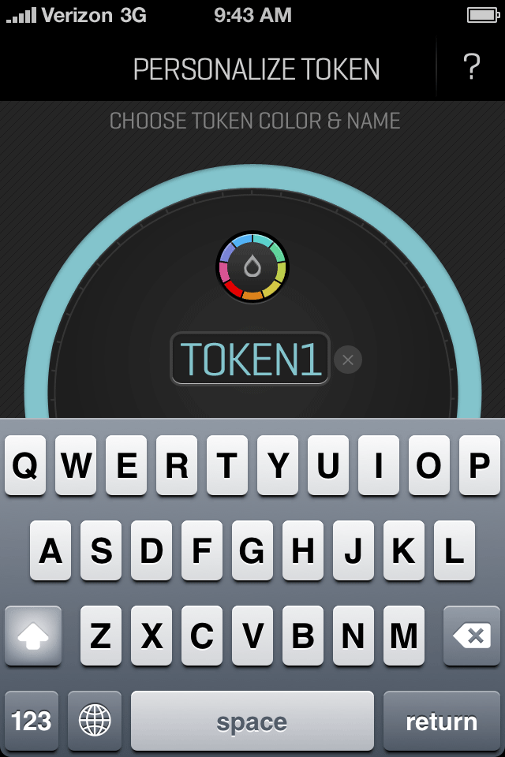
User Activates Token (1 of 2)
Keyboard: Keyboard is not quite native – dark skin (not sure if we will keep this)
Processing/Success: Most of the screen is blank (I’m not crazy about it, PM thinks its fine.)
DESIGN FLOW

Slide 5
User Activates Token (2 of 2)
Personalization: Uses the same screen as Edit; but some text is different
Screen Up: Screen moves up to accommodate text field.
DESIGN FLOW

