Slide 1
VATI: Virtual ATI
A Learning Management System (LMS) for NCLEX Exam Prep

Slide 2
“VATI” Virtual ATI a LMS System for Exam Prep
What is the goal of the project? The goal is to guarantee within a small percentage points that students will pass their NCLEX exam and become a certified RN or LPN.
We accomplish these goals by providing a self-paced virtual test prep product where the student has a personalized experience based on their existing skill sets. The student is coached by a live person as they move through the product. We also accomplish our goals by creating our own LMS, instead of using Moodle. This will allow greater customization and integration of a broad variety of content creators (Simulation based Kognito modules or Traditional skills-based tools/flash cards/animations)
What is the problem we are solving: Currently, ATI offers a product that is used with instructors in the classroom called “ATI Capstone.” Capstone contains some NCLEX prep but is a much larger in classroom product. VATI (or Virtual ATI), is the natural extension of that and solves the problem of providing a full solution solely on 100% Virtual exam prep, rather than a partial/intro one with Capstone. The value here is that faculty at nursing schools have more time to teach other things in the classroom, besides test prep as students go through this self paced course.

Slide 3
Who are our users?
Approaches to solutions Include:
Design thinking which focuses me more on what our user’s goals are and is best done in the initial phases of the design.
Later, UCD is applied to ensure the GUI helps our users to meet their needs.
The Primary users are nursing students who want to pass their NCLEX exam to be a RN or LPN.
Secondary users are the coaches of the system, that monitor the students work and provide personalized recommendations and feedback.
Tertiary users are the faculty at nursing schools who review results with their students through reports.
Project Impediment and the Solution
When I’m asked to join a project, the PO or PM wants to start wireframing right away because of the timeline of the project (4-6 weeks in this case).
I’m not always brought into work early enough to accomplish a lot of persona work or other types of research (contextual inquire for example) .
I want to accommodate the needs of the business, but also serve the customer. My solutions are two-fold: First, I ask if the BU has any persona’s done in the past. Second, I look at supporting documents such as a BRD to see if I can get some user profiles from there. Additionally, I see if any stakeholder interviews have been done to incorporate more insights into who the customer is and what they want – besides relying on the PO/PM to do so.

Slide 4
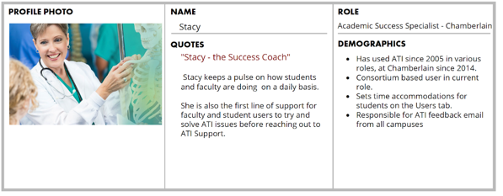

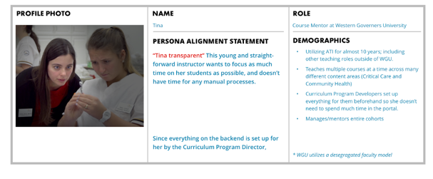
Solution: Alignment Personas
Personas that are created for the entire company, a big bunch of products or services, or a big division in the company, and end up being too broad or data-driven to be helpful.
Those created across the organization or comprehensive products are expensive and end up being ignored.
Therefore: Alignment Personas were created
Coined by former Amazon employee, Tamara Adlin.
Alignment personas came out of her failures to produce data-driven personas across all of Amazon:
They were, “little, specific, precise, ad-hoc, assumption-based personas aligned the interdisciplinary teams and the problems they were trying to solve.”
Personas reflect real user patterns, not different user roles.
Focus on the current state (how users interact with the product); not the future state.
Context-specific
Personas should be aligned to teams, products, and most importantly, the problems they are trying to solve.
(All aligned to clear and measurable business goals.)
After looking through project documentation (BRD, PRD), I found existing alignment personas. Since my part of the project focused on the Student Experience, I was able to add to the alignment persona with supporting information from the BU and add to ATI’s alignment persons for VATI
STUDENT
COACH
PROFILE PHOTO
NAME AND ROLE
Nancy - Last Year Nursing Student
PESONA ALIGNMENT STATEMENT
PESONA ALIGNMENT STATEMENT
“Now Nancy” A young eager nursing student is anxious to get to a role in the nursing field…yesterday! She enjoys the classroom and the learning process – wanting to get “good grades. "She is eager to control her own destiny to get her license and ”get this school thing over with.”
FACULTY
DEMOGRAPHICS
In her early to mid 20’s using ATI products through Chamberlin University.
Also works a part time job
May have a young child in her household with a husband who is also working
Balances school and work as best as she can.

Slide 5
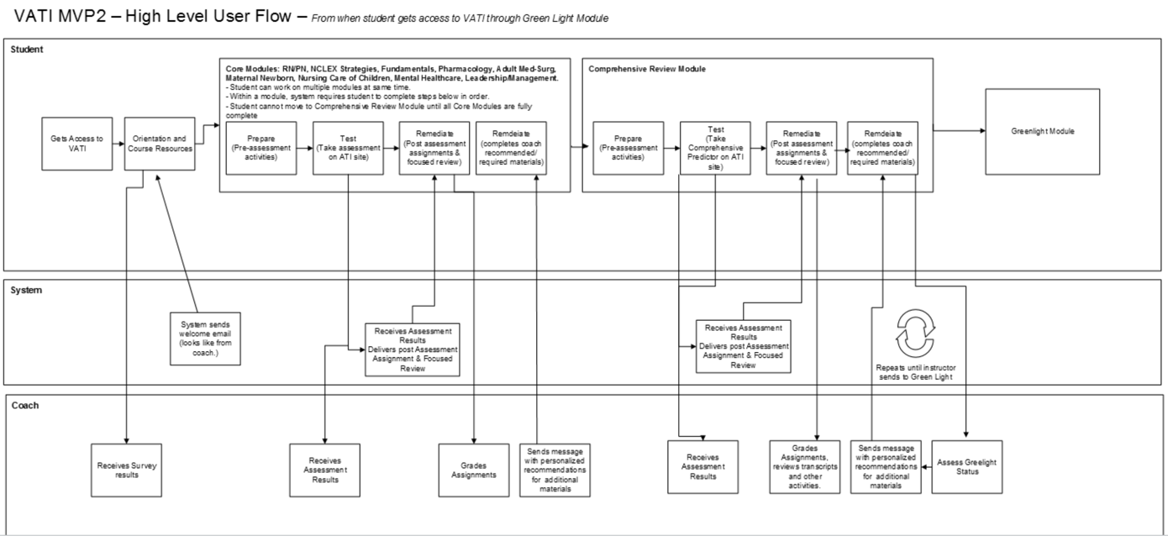
Student User flow
Gating between core modules and the review modules. In each section the learning loop takes place.
Prepare & Test & Improve
Prepare & Test & Improve

Slide 6
Preparing for Usability Testing
We will see the what we tested for, and the results in the next slides.
Note that we had artifacts such as test scripts and user zoom recordings.
PM, Dev and other Stakeholders were able to listen in and review these items at anytime in the process.

Slide 7
Wireframes
A/B Testing of Two Dashboards were created for students that we tested with.
(Myself and an intern)
The first one was a simplified view with To Do and Completed Items
The second one was showing all modules on one page.
The concept was: Do students like to see all of their material in one view, or do they prefer the feeling of organization and accomplishment with the To Do and Completed. Remember, our core persona is eager to knock things out and check them off.
Also notice that the dashboard has a visualization to add some delight to users who enjoy accomplishment.
I not only have an area for student/coach messaging, but on the dashboard the student's coach can interact with them via messaging, yet it gives the feeling of live interaction, of the coach interacting with the student throughout the process.
Dashboards and Learning Loops

Slide 8
Wireframes
Students complete a series of activities to prepare them for the module they are in. In this case it’s Fundamentals.
They then “test”. Finally they move on to the “improve” tab where they are given required and recommended activities.
Dashboards and Learning Loops (Prepare, Test and Improve)
This is the learning loop.
Note that students know how many modules they have to do to complete a section.
Something to point out here, was an assumption I made and tested for was the title of Required vs “Coach Recommendations”
Do students in the test understand which items they must do vs. which ones are not required.
Do they feel that the coach recommending modules provides enough personalization for them, or would they just ignore them because they aren’t under the required header?
Will students ”Loose trust” in the system if we mark items such as an ebook or a concept map as completed if just opening and closing the material sends that status without them doing any actual work?
I knew what my might be, but PO/PM was not convinced at this stage.

Slide 9
Findings
Were our assumptions correct?
What did we learn?
Any surprises?
Results were socialized in a PPT deck with stakeholders. They then become a qualitative metric (aggregation of comments in for each workflow) as well as a quantitative metric (x out of Y participants prefer dashboard A to B) that serve as a benchmark moving forward in iterations of the next release.

Slide 10
Usability Testing – Dashboard Findings
DESIGN A
DESIGN B
This data supports the design decisions of Design A
5 of 6 users strongly preferred Design A - Both versions of the dashboard performed well from usability standpoint, though users “wanted to be able to see everything they did” on one page. I learned that while students liked the feeling of accomplishment, they favor the feeling of control. They didn’t like the system ”hiding things” on them, even if they knew how to access it.
Like progress indicator close to days left and NCLEX date
Can easily see where they are on all modules Again, this speaks to users wanting control of the system, a basic Heuristic in UX Design.
Messages from their coach was seen as a ”great help” because they want to know when grades are ready, or other important dates. They felt like “someone real was checking in on them” (which someone is!)

Slide 11
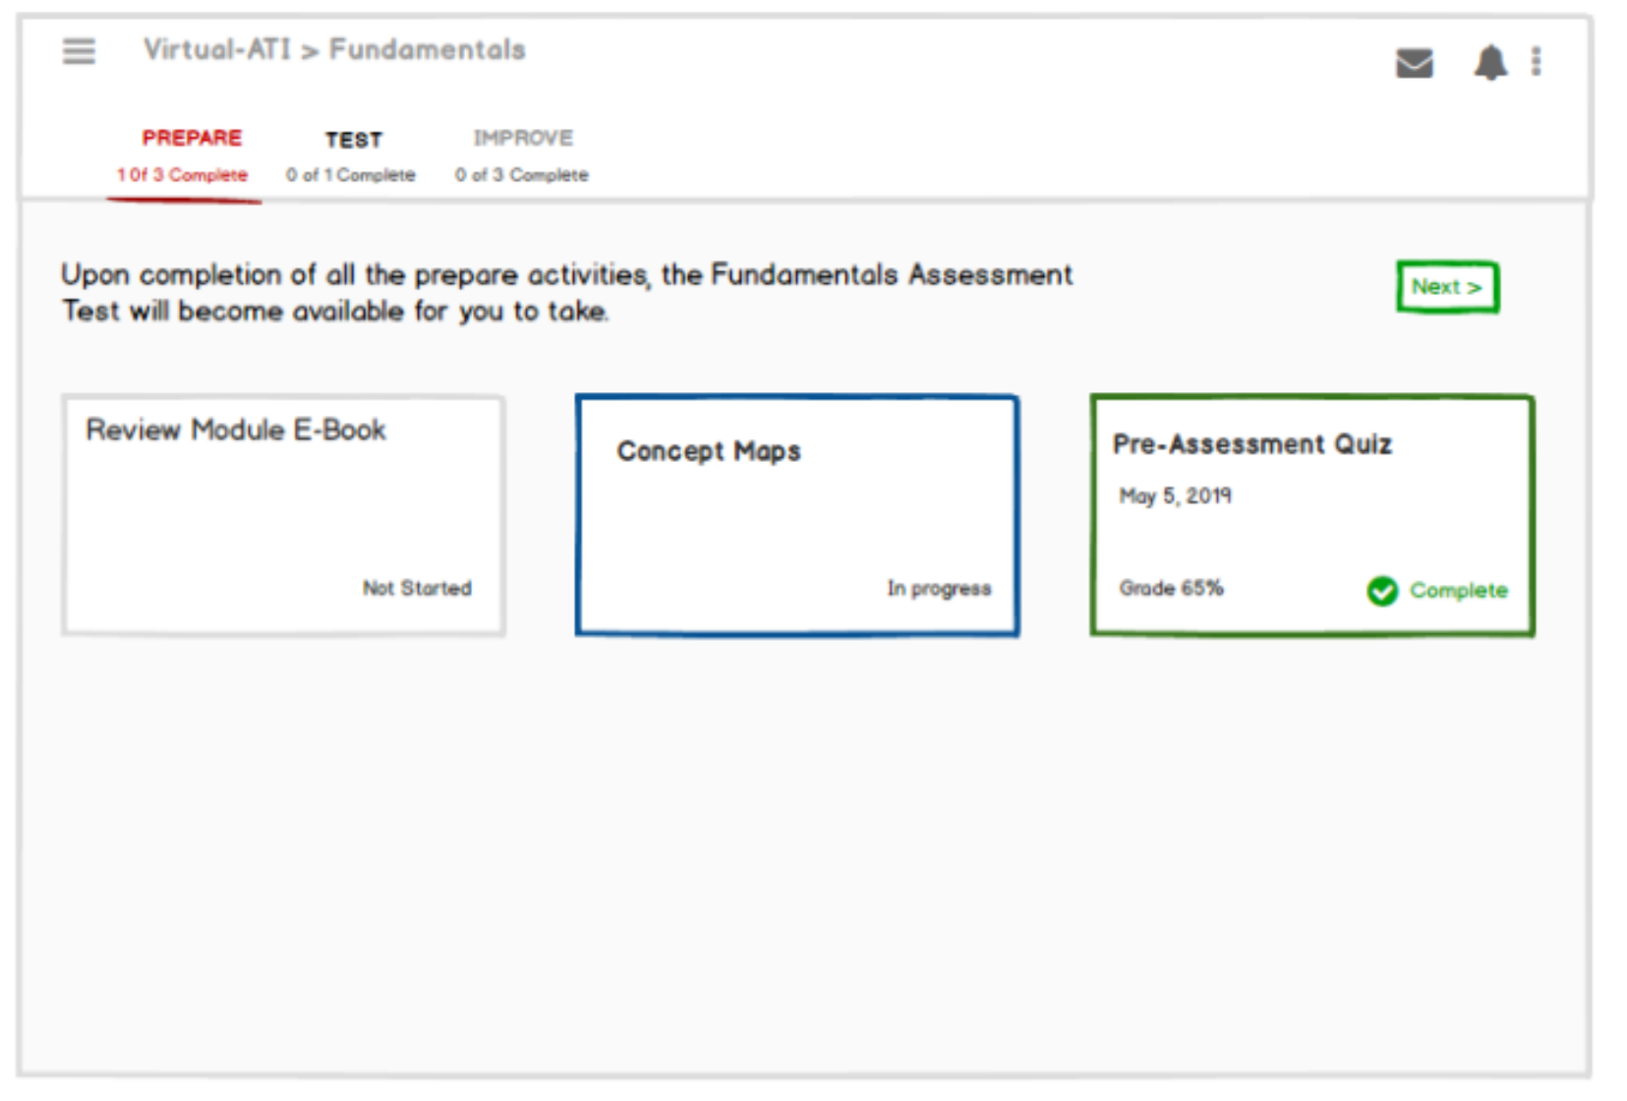
Usability Testing – Learning Loop Findings
The learning loop consists of Prepare Test and Improve
PREPARE
This data shows us changes are needed
What was observed for Prepare:
  It was not clear to users what learning activities were required to progress forward and to get “complete” for module.
  Many guessed all were required because the Prepare tab says “1 of 3” complete
  Students verbalized that “completing” sometimes means you just have to open a task, or do part of it
Why this is Important
  If there isn’t clarity, some students will do everything (which may or may not be right for them) and others will figure out how to get around it
  The more certain users are about what they need to do and the more they trust the system to guide them, the better compliance ATI will have in encouraging the right behavior

Slide 12
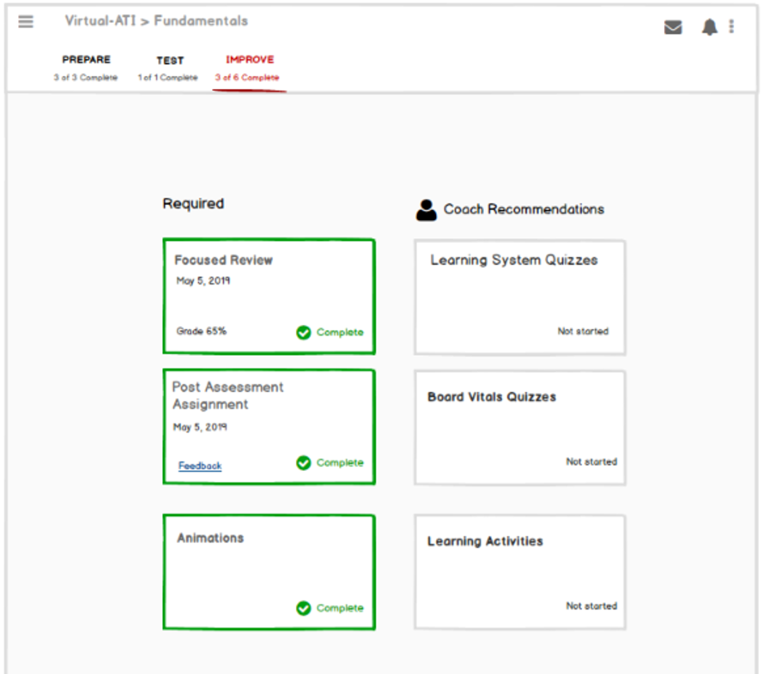
Usability Testing – Learning Loop Findings
The learning loop consists of Prepare Test and Improve
IMPROVE
This data shows us some design decisions worked and other areas need more work.
What was observed for Improve:
  They liked seeing required and recommendations, which they had hoped to have seen in the prepare section.
  Participants didn’t see or access “Feedback” link in Improve Tab
  Students were not at all clear that they should review feedback at this step
Why it happened:
Not visually prominent
  Feedback is not located where students expect; they expected it under “Coach Recommendations”
  Students don’t naturally use the word “feedback” for what this is. They think of it as getting graded.
  The student’s mental model is that they submit their assignment to be graded, and then they receive the graded assignment back from the coach.

Slide 13
How did our metrics influence the new design?
What did we learn about the dashboard?
What did we discover about the learning loop?

Slide 14
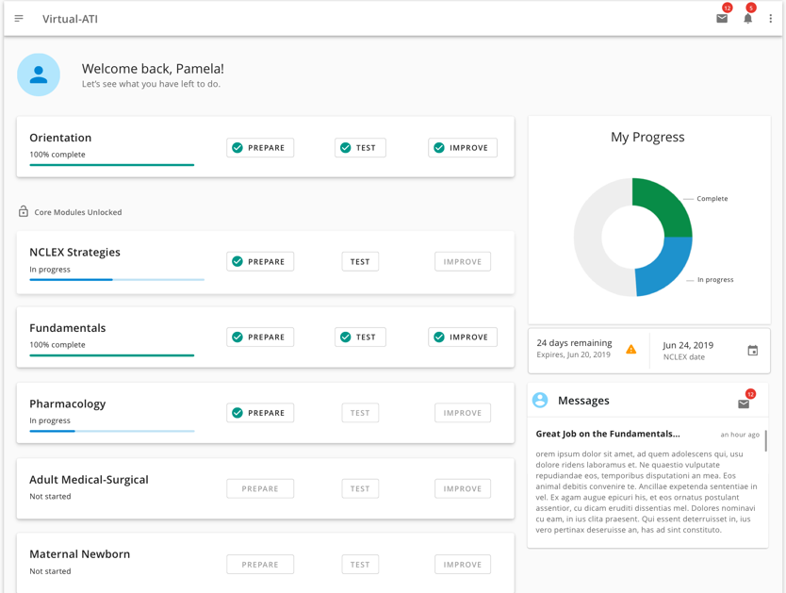
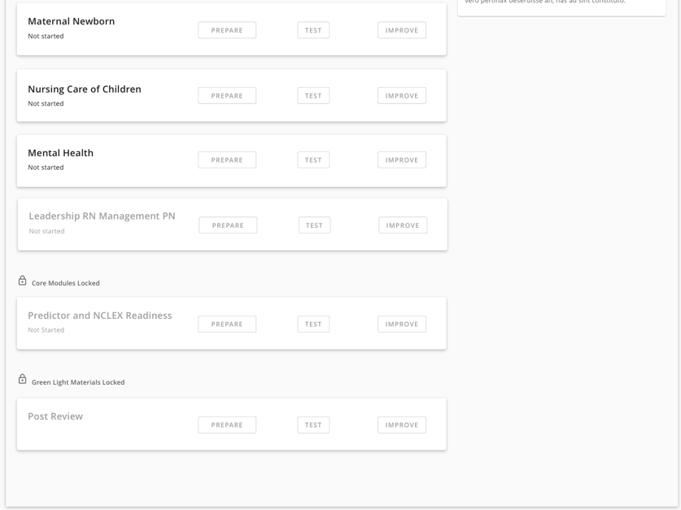
Final product: Dashboard
This data supports the design decisions of Design A
Additional feedback from what you saw on slide 9
Navigation: users were successful navigating through the course content from dashboard, through Prepare, Test and Improve
  “There’s structure here ..I can see where I am and how to get where I want to go.”
Move at own pace: participants understood through the UI design that they could move forward to next Module without waiting for coach to unlock; very positive response!
“It’s a relief I don’t have to wait for the coach to unlock anything, it’s really at my own speed.”
Progress: the interface supported user’s understanding of their progress through the material
  Modules status on dashboard was clear
  Progress indicator well-received and understood
  “I like that wheel of progress, plus I can tell with the checks which ones are done.”

Slide 15
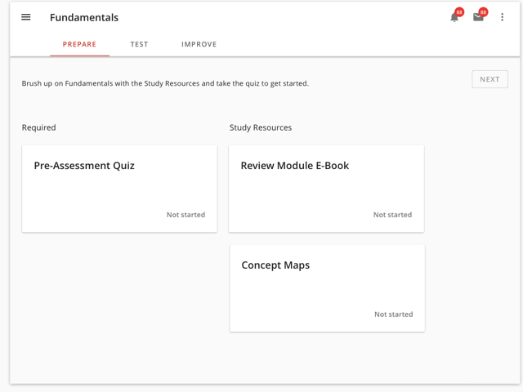
Final product –updated wire and sketch file
I was able to prove my assumptions based on feedback from users. As a reminder PO/PM wanted to display all data to students without letting them know which ones they “had to” do. They felt it was all important. However, If everything is important then nothing is.
I had separated modules into 2 groups: Required and Study Resources.
I addressed the issue of trusting the system, by ensuring that I changed the status label of “complete” in modules that were not graded to “Last Accessed: <date>” which was more accurate.

Slide 16
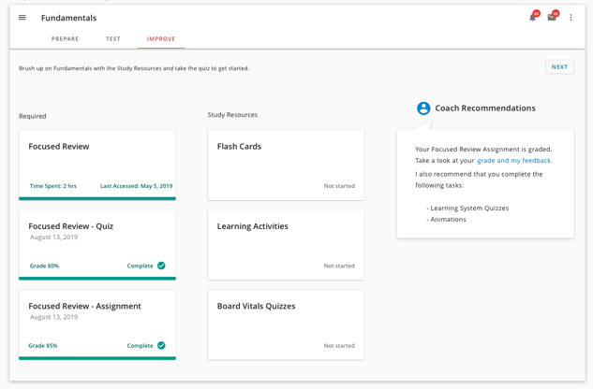
Final product –updated wire and sketch file
I changed “Coach Recommendations” to “Study Resources” the labeling conventions were consistent in all areas of the learning loop.
The message from the coach is now called “Coach Recommendations”
Additionally, I added Last Accessed and Time Spent in the Focused review because it is not graded. However users expressed the desire to know if they had gone through the module, and how much they spent on it.

Slide 17
Final product
What would you have done differently?
Ask for user feedback of the materials being provided. Students do like them, but which ones are more successful and why? Which ones are not as successful and why? Then let’s remove anything that doesn’t’ work and re-tool our courseware.
Perhaps adding additional metrics and a variety of the type of metric. For example A second round of unmoderated usability testing with new participants to see if there were any loose ends, or request for new features toward a v2. As opposed to a moderated test. Also, perhaps a scorecard test so we have numeric values to use as comparison for our v2 product. It would be great if we could work closer with development on page load times and being looped in for any rage clicks using a log analytics tool like log rocket.
What did you learn?
That students like control of the system, even when we think we are making it easier for them. For example, Dashboard B had the 2 tabs and I thought that they would like it if we moved the completed modules into a ”done” tab. They didn’t like that. I think the reason was 2-fold, yes they liked visibility of all cards on one screen, which helped with control of the system – but they also liked being reminded of accomplishment in one central visible spot.
Students do not want a lot of extra information; however they do value being able to access it. We learned this through our usability testing. Product was saying, “they love our test prep products so we don’t want to leave those out” but the distinction I needed to make was how to alleviate the feeling of being overwhelmed by materials but still providing enough that education so they can achieve the high probability of passing.

Slide 18
Did you meet/exceed the goals?
How do you know it was successful?
Through Usability testing I was able to validate assumptions and makes some changes as where users indicated preferences.
Validated usability of the design for helping students navigate successfully and without confusion through the primary flow of completing modules, lessons, quizzes and assessments
Validate that the design supports appropriate access to results, messages from coaches and feedback on graded assignments from their coach.
Determine whether the design supports students understanding of what is required vs. optional, needs to have been completed in order to progress to a new step and for a module to be marked as complete.
Get feedback and usability task data to inform design decisions for the dashboard.
We received positive finding metrics which helped myself, the PO/PM team to know the design was a success.
5 of the 6 Existing users of the capstone system users agreed that this product was a must have for them.

